Slide 1
Maďarsko
Marek Kačmár
3.A

Slide 2
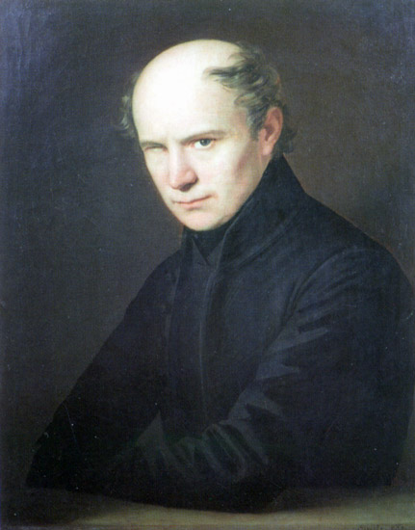
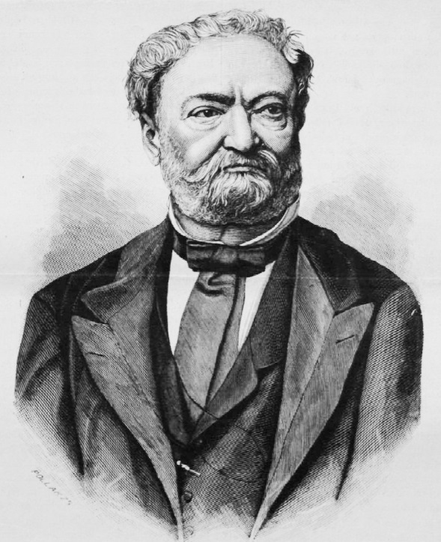
Maďarská hymna
Slová: Ferenc Kölcsey =>
Hudba: Ferenc Erkel

Slide 3
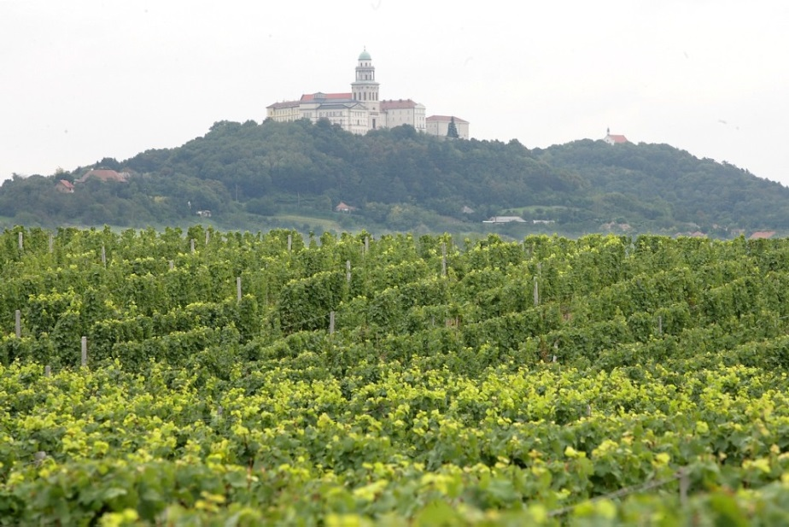
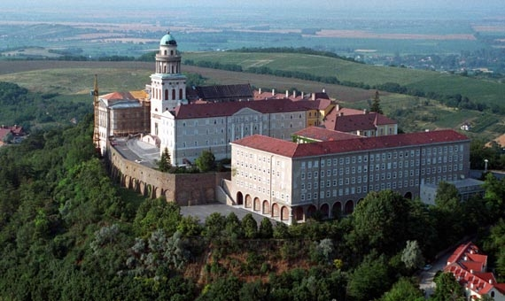
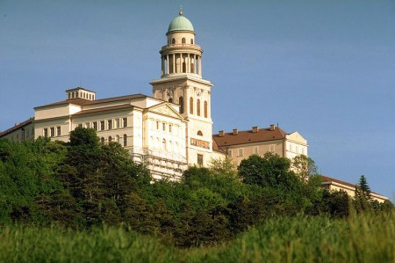
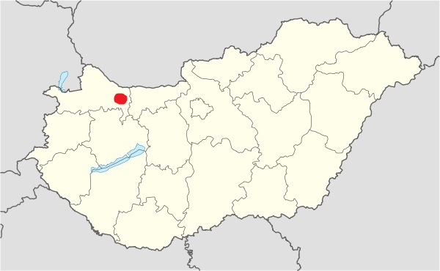
Pannonhalmské arciopátstvo

Slide 4
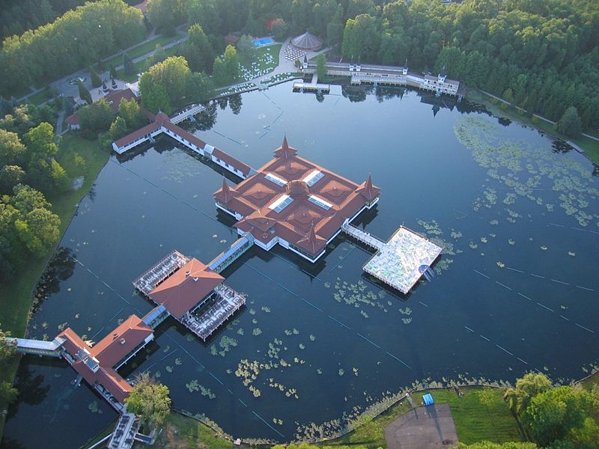
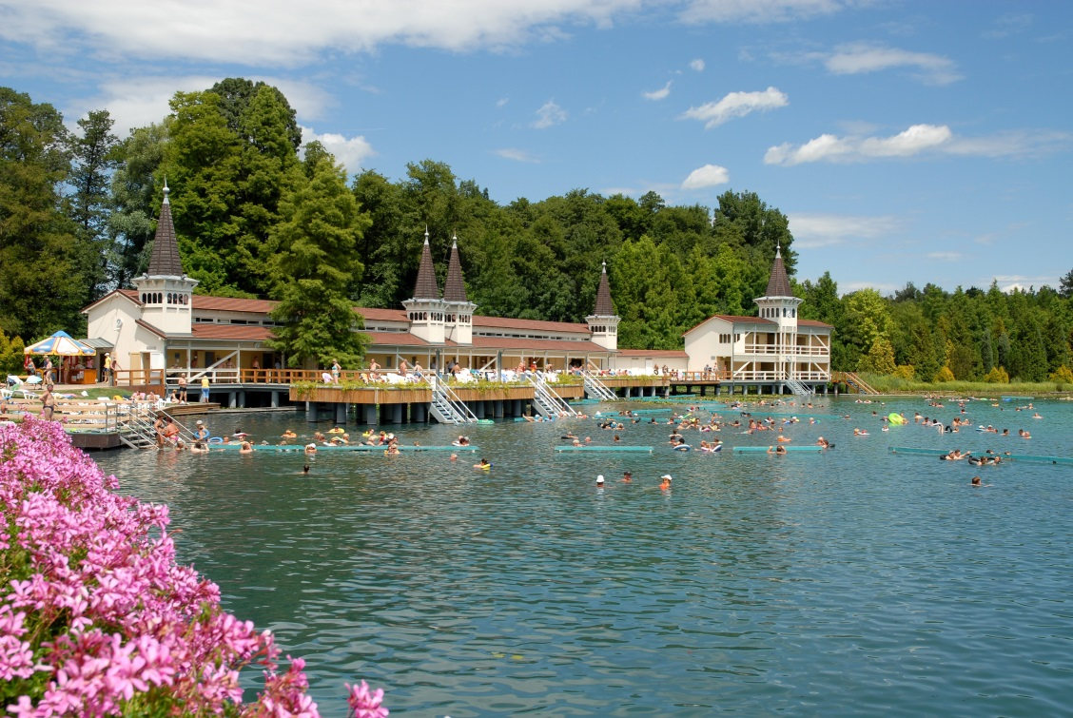
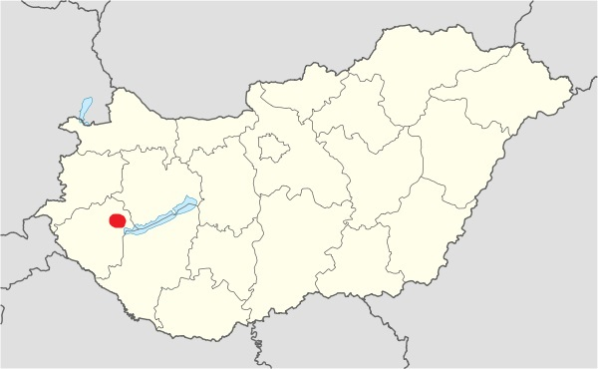
Jazero Hévíz

Slide 5
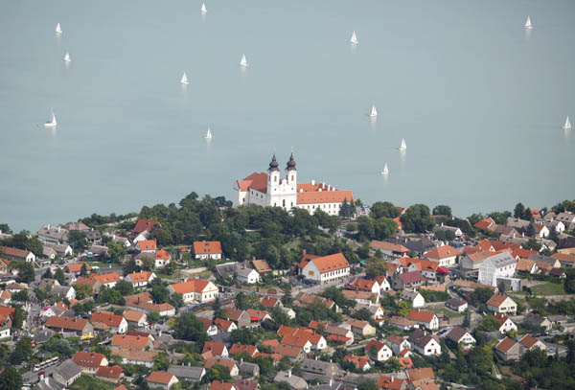
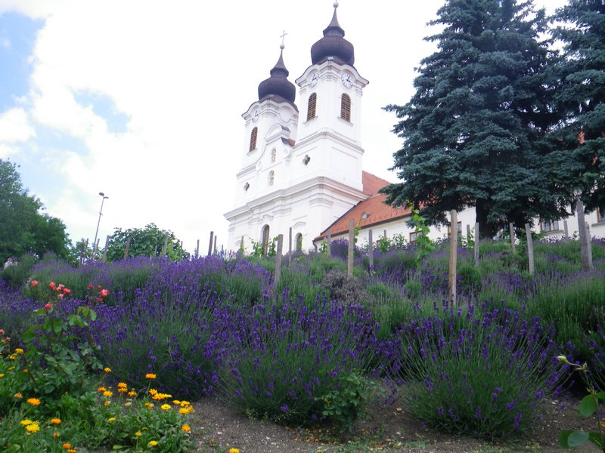
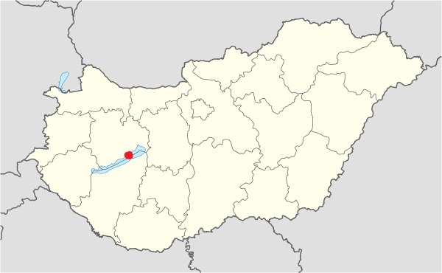
Tihany

Slide 6
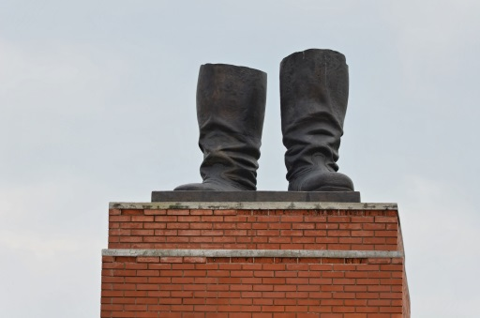
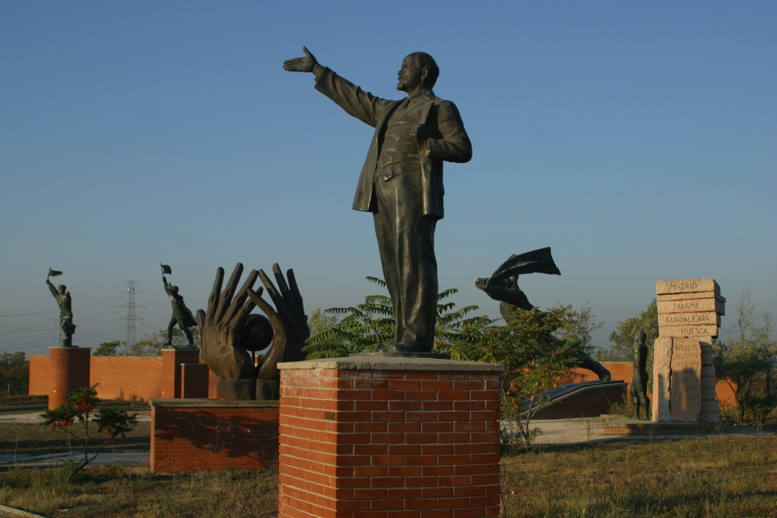
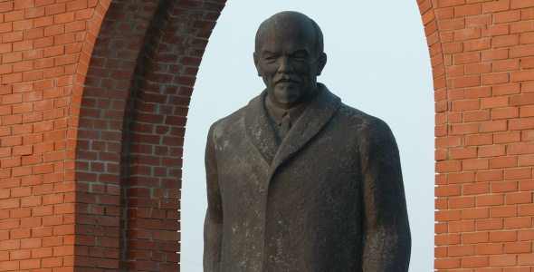
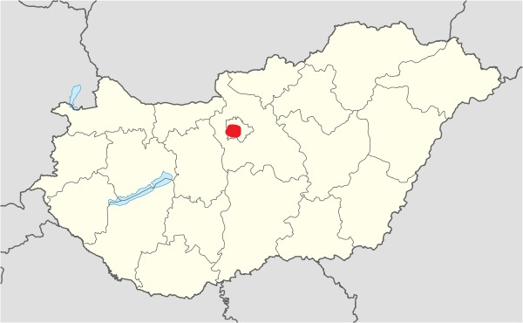
Park Memento

Slide 7
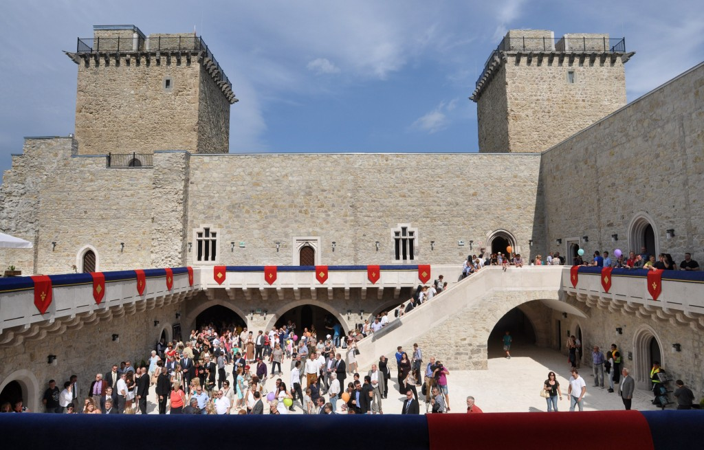
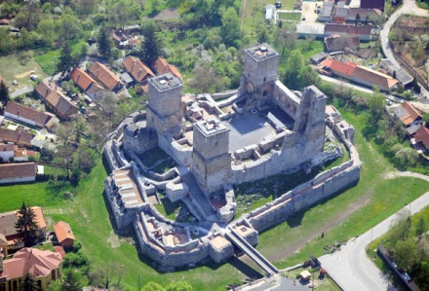
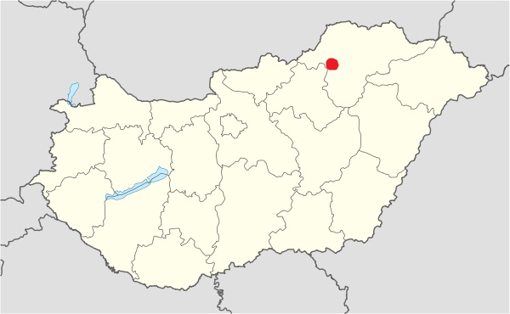
Hrad Diósgyőr

Slide 8
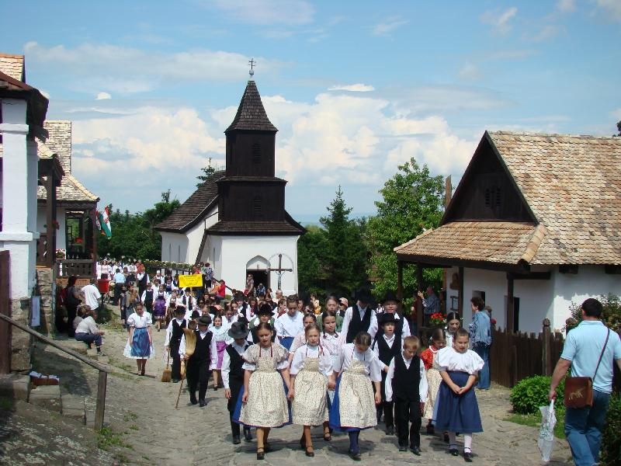
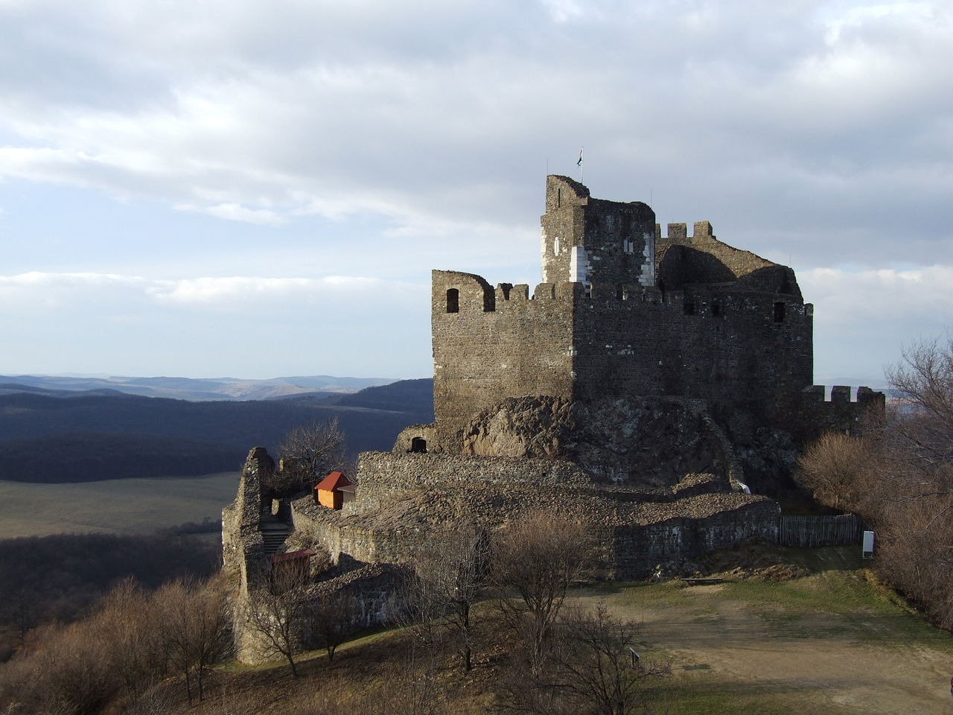
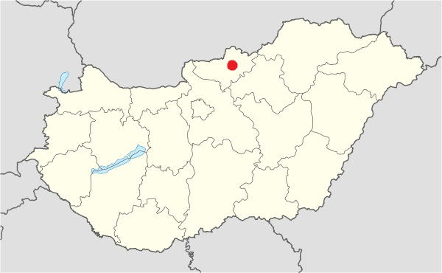
Hollókő
Video

Slide 9
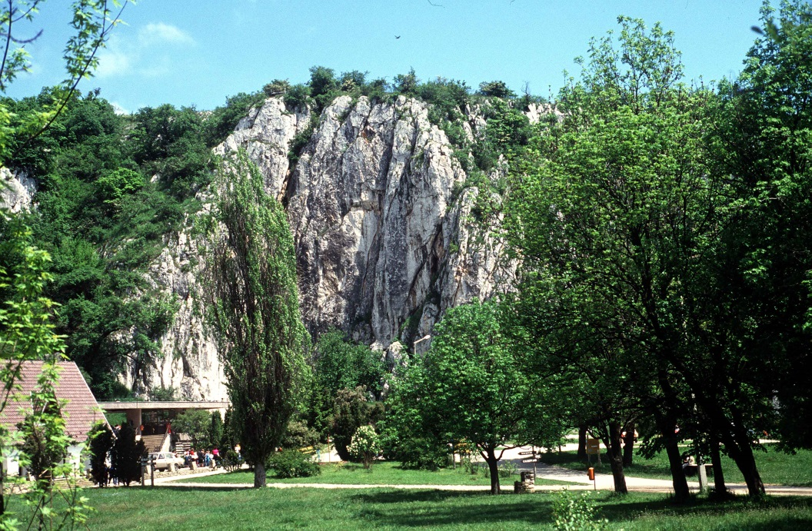
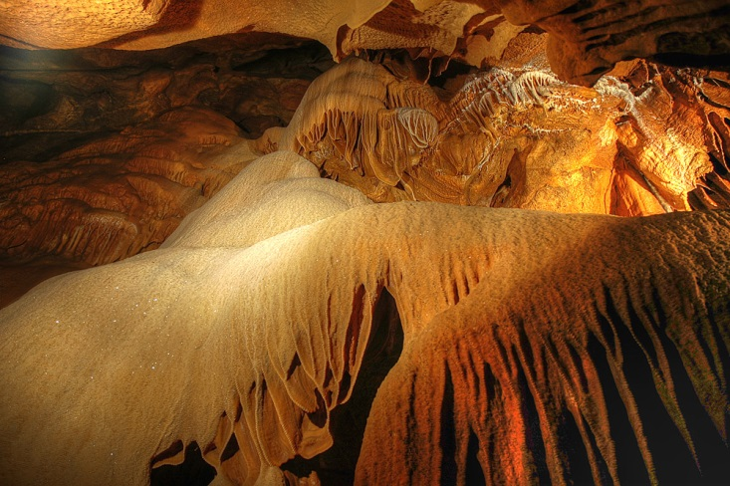
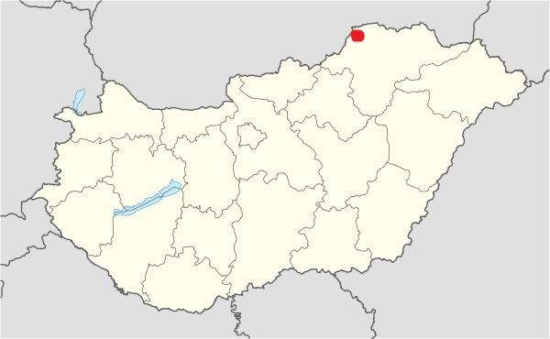
Národný park Aggtelek

Slide 10
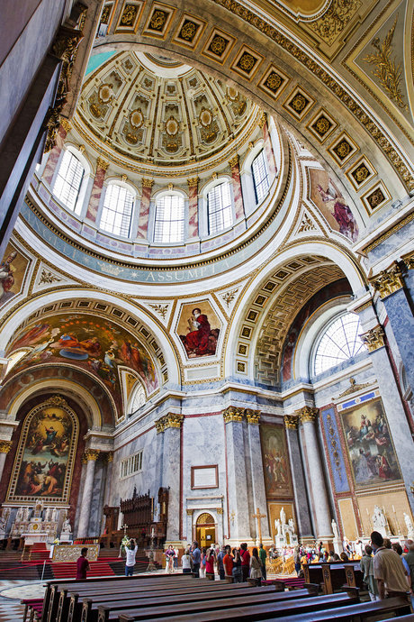
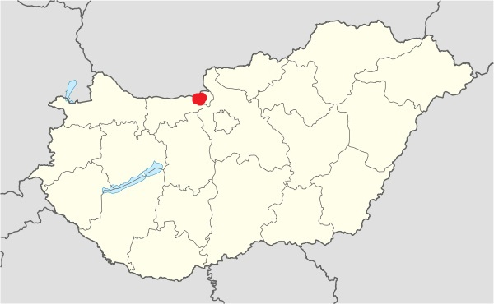
Ostrihomská bazilika

Slide 11
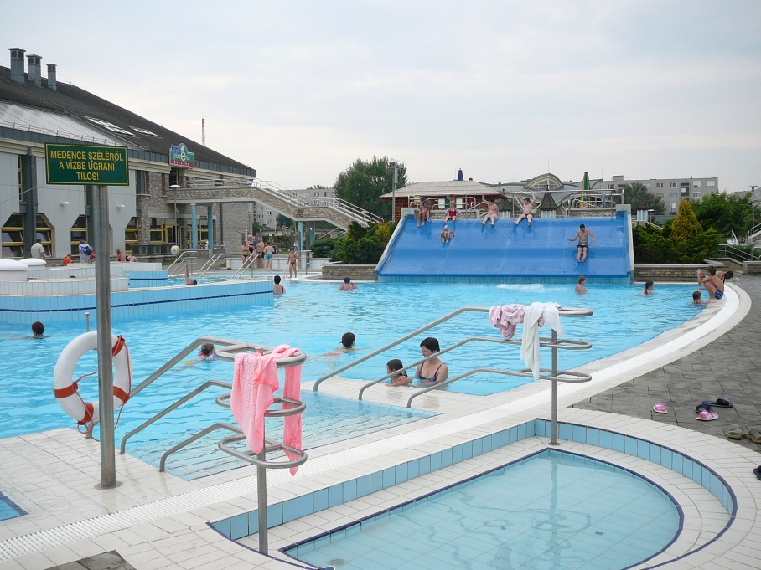
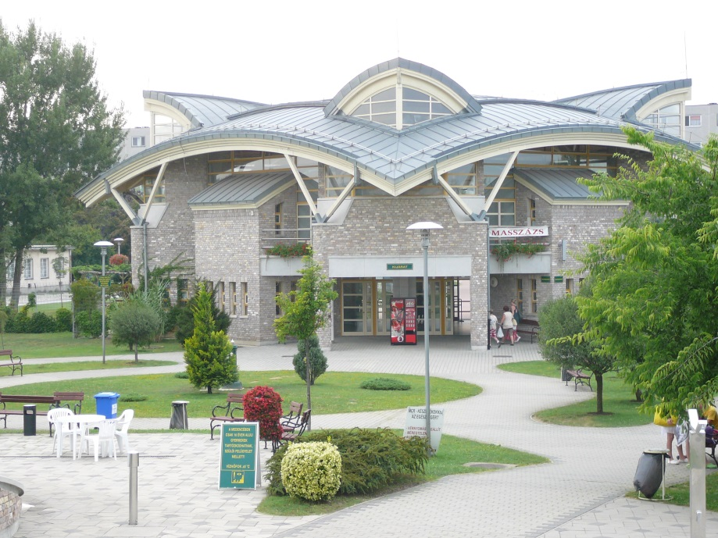
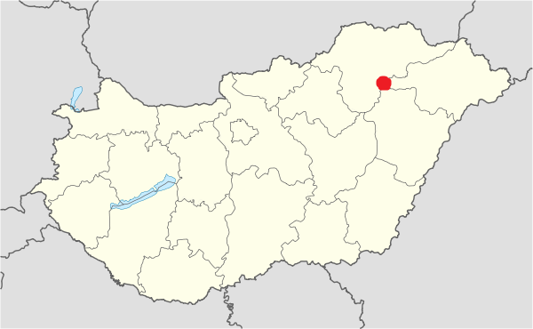
Tiszaujvárosz

Slide 12
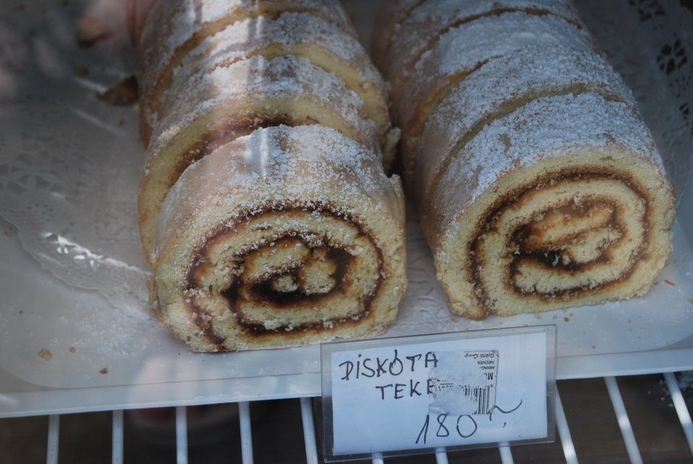
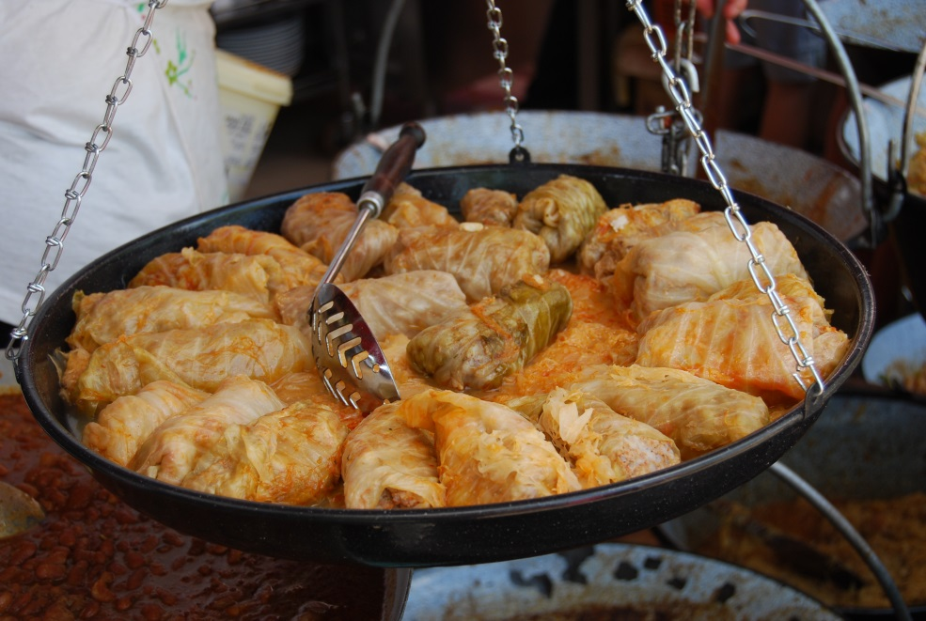
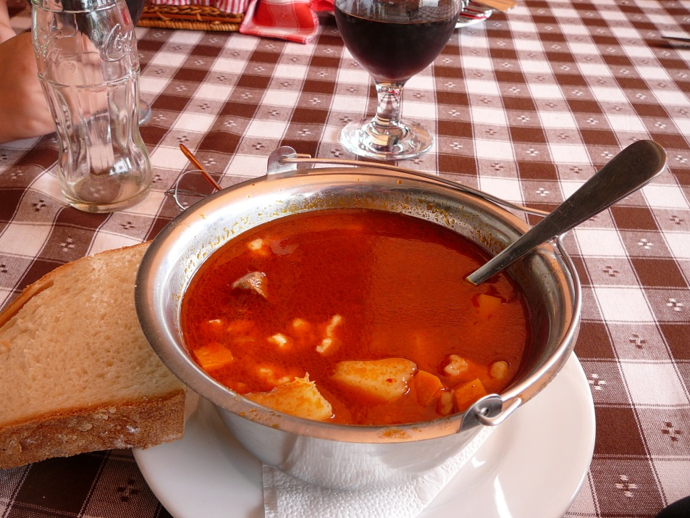
Tradičné maďarské jedlá

Slide 13
Zdroje
http://avasi.hu/sites/default/files/tartalom/egyszer/kolcsey.jpg
https://www.youtube.com/watch?v=_N3gfzk-5bw#t=0m12s
https://upload.wikimedia.org/wikipedia/commons/c/c4/Erkel_Ferenc_Poll%C3%A1k.jpg
http://files.annatour.sk/system_preview_detail_200012536-f257e0027e/PANNONHALMA_01.jpg
http://www.bestofbudapest.com/images/accomodation/trends/large/8/pannonhalma_001.jpg
https://upload.wikimedia.org/wikipedia/commons/thumb/a/ac/Hungary_location_map.svg/600px-Hungary_location_map.svg.png
https://upload.wikimedia.org/wikipedia/commons/2/2b/H%C3%A9v%C3%ADz.jpg
https://upload.wikimedia.org/wikipedia/commons/3/36/H%C3%A9v%C3%ADz_1.jpg
https://upload.wikimedia.org/wikipedia/commons/4/4f/Okt_15.jpg
https://upload.wikimedia.org/wikipedia/commons/d/db/Vass_imre_narancszuhatag.jpg
http://tourinform.hu/site/upload/2007/11/n4512.JPG
http://visitbudapest.travel/images/content/gallery/327/statue-park4__big.jpg
http://visitbudapest.travel/images/content/gallery/327/statue-park2__big.jpg
http://budapest.gotohungary.com/site/upload/2009/01/mementopark1.jpg
https://upload.wikimedia.org/wikipedia/commons/6/61/Diosgyorcivertanlegi3.jpg
http://mw2.google.com/mw-panoramio/photos/medium/56043756.jpg
http://www.mvkrt.hu/kepek/2014/08/2906-thumb.jpg
http://www.gastroweb.sk/app/cmsPhotoGalleryImage.php?disposition=i&width=1000&ID=1111&name=127%20-%20Pannonhalmi%20F%C5%91ap%C3%A1ts%C3%A1g%20-%20L%C3%A1tk%C3%A9p%20a%20sz%C5%91l%C5%91%C3%BCltetv%C3%A9nyek%20fel%C5%91l.jpg
https://upload.wikimedia.org/wikipedia/commons/thumb/0/08/Holloko1.jpg/1280px-Holloko1.jpg
https://upload.wikimedia.org/wikipedia/commons/thumb/a/a6/Castle_of_Holloko_with_Panorama.JPG/1280px-Castle_of_Holloko_with_Panorama.JPG
http://www.holloko.hu/pic/original/BC25ED91FBCC3883B2E7B68B289B5E62.jpg
https://utazom.com/sites/default/files/kep/39847/tihany_4.jpg
https://www.google.sk/url?sa=i&rct=j&q=&esrc=s&source=images&cd=&cad=rja&uact=8&ved=&url=http%3A%2F%2Fwww.ski-bike.cz%2Ffotogalerie%2Fmadarsko-heviz-cerven-2011%2F&psig=AFQjCNH3lNRU5WlVgUqGiLZ_etAOD6XEJQ&ust=1441899576326117
https://upload.wikimedia.org/wikipedia/commons/d/d3/Tihanycivertanlegi2.jpg
http://comlegendaed.com.br/wp-content/uploads/2015/07/boryv1.jpg
https://upload.wikimedia.org/wikipedia/commons/3/3b/Szekesfehervar_Orb_and_Episcopal_Palace.JPG
http://www.legifoto.com/jpg_menukep.php?szeles=600&kep=menu_kepek/pecs_kiserokep......jpg
http://www.mementopark.hu/pages/sights/
http://sk.gotohungary.com/zaujimave-programy-atrakcie-priroda/-/article/madarsko-miskolc-hrad-diosgyor;jsessionid=1B2F1BA043BC5D382123A02D25A37C30
https://sk.wikipedia.org/wiki/Stoli%C4%8Dn%C3%BD_Belehrad
http://www.jednodenne-vylety.sk/vylety/jednodnovy-vylet-ostrihom-katedrala.jpg
http://img.cas.sk/img/4/article_body/2088505_ostrihom-bazilika-ostrihomska-bazilika.jpg?hash=9cd1b6b1b2ac0c6811483a325844ec81
http://www.wellnesstips.sk/turisticke-zaujimavosti/ostrihom-esztergom-bazilika_124_1.html
http://varecha.pravda.sk/usercontent/images/velky-recept2072_1273232656.jpg
http://www.moje-dobroty.cz/wp-content/uploads/2012/03/halaszle.jpg
http://img6.hvg.hu/image.aspx?id=cfdba97c-92e6-40a7-8272-62c2d3e14d77&view=7fcefbf8-ac48-4ee6-aef5-32203afa118c

Slide 14
Ďakujem za pozornosť

